Slide 1
THE WATERS OF MY COUNTRY - CROATIA
https://spark.adobe.com/page/v7eePGxoYrKHM/

Slide 2
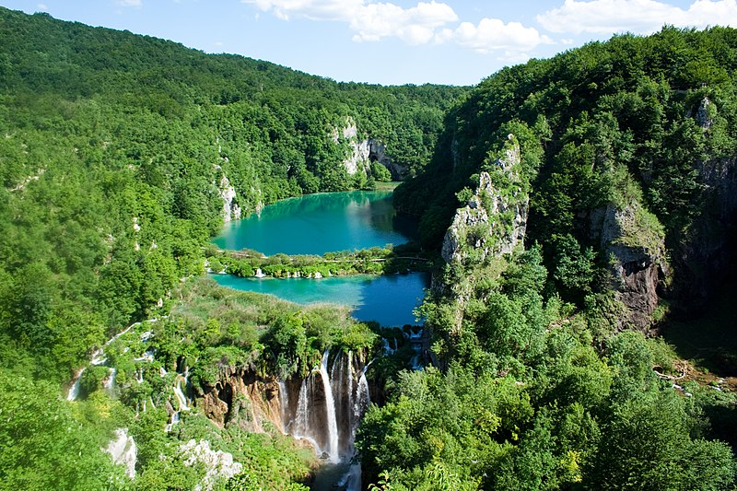
Lakes and Groundwater
Plitvice Lakes
Plitvice Lakes National Park was declared a national park on April 8, 1949. It is the largest, oldest and most visited Croatian national park. There are 16 lakes of different sizes in the park, filled with crystal blue-green water. The lakes get their water from numerous rivers and streams, and are interconnected by cascades and waterfalls.
Plitvice Lakes
Source:https://upload.wikimedia.org/wikipedia/commons/9/9d/Plitvice_Lakes_National_Park_%282%29.jpg

Slide 3
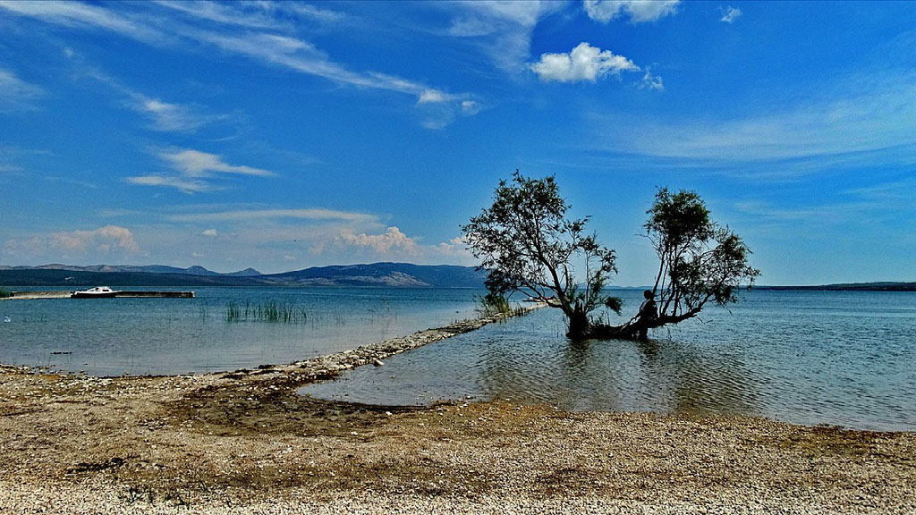
Vransko Lake
Vrana lake is the largest natural lake in Croatia. This lake is actually a karst field filled with water and a rare example of cryptodepression.
Source: https://commons.wikimedia.org/wiki/File:Park_prirode_Vransko_jezero_1.jpg

Slide 4
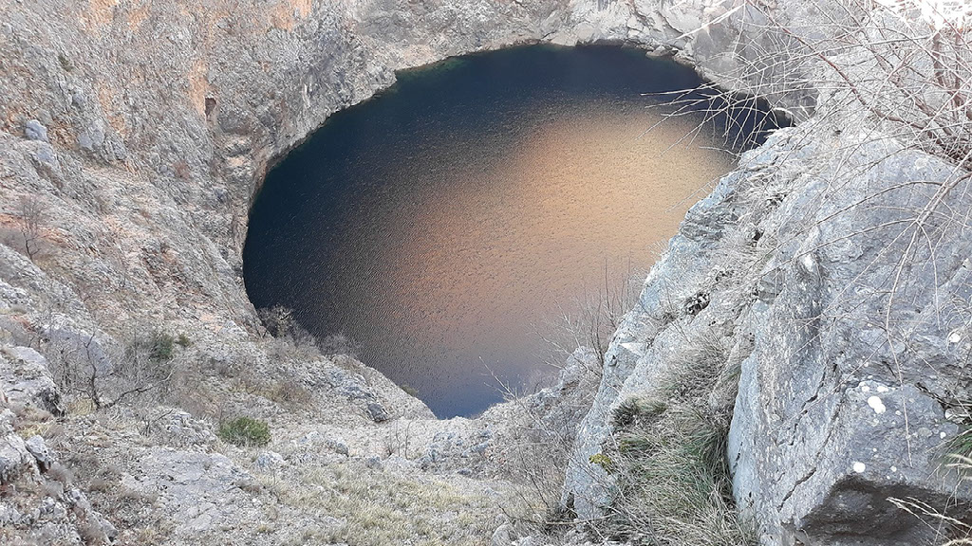
Red Lake
Red Lake is a karst pit filled with water near Imotski. In 1998, the Croatian Speleological Association organized an international speleological diving expedition, during which the height difference of 528 meters and the depth of the lake of 287 meters were precisely measured, and according to some data, it would be the deepest lake in Europe. The lake was formed by the collapse of the vault above the pit. There is a legend about Gavan's palaces, according to which in the ancient past there were palaces above the lake that collapsed into the ground, and a lake was created at that place. It is named after the red rocks at the edge of the lake.
Source: https://commons.wikimedia.org/wiki/File:Red_Lake_Imotski_002.jpg

Slide 5
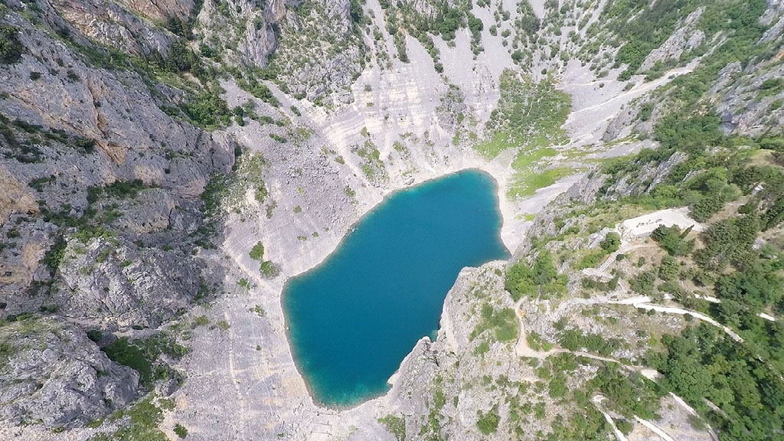
Blue Lake
Blue Lake is a karst lake near Imotski. It is considered one of the most beautiful karst lakes in Croatia. The lake is located below the gorge where the Topana fortress is located. Its water level fluctuates considerably throughout the year so it is not uncommon for it to dry out completely. In these cases, football is played at its bottom. During the summer months, there is usually enough water for swimming, and it is not uncommon to play various water sports. Special care is taken of water quality and tidiness of beaches and the environment by planting and nurturing suitable Mediterranean species.
Source: https://commons.wikimedia.org/wiki/File:Modro_jezero.jpeg

Slide 6
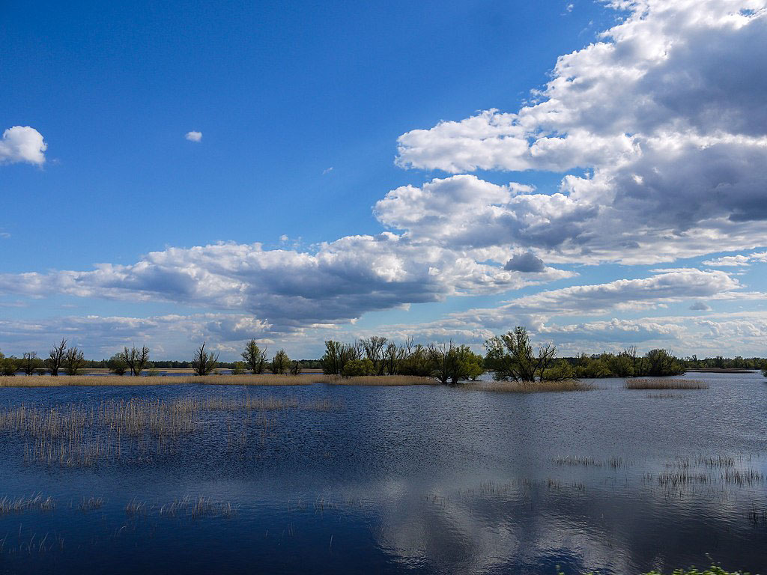
Kopačevo Lake
Kopačevsko or Kopačko Lake is a natural lake in Osijek-Baranja County. Kopačevsko is the largest lake located in the Kopački rit nature park.
Source: https://commons.wikimedia.org/wiki/File:Kopacki_rit.jpg

Slide 7
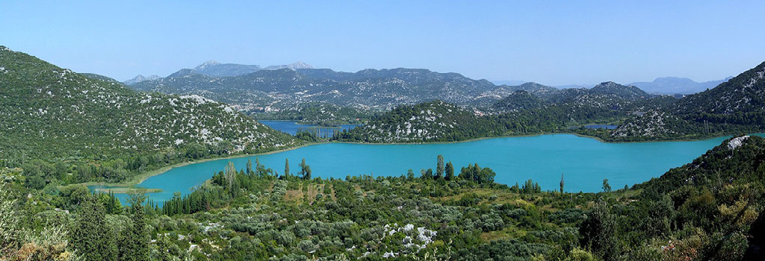
Baćina Lakes
Baćina Lakes are a set of karst cryptodepression lakes in Baćina near Ploče. They consist of six connected lakes and one separate lake. The water in them is sweet, and there are springs that are connected directly to the sea. In the area of Klokun near Plitko Lake there is a spring that provides drinking water for the city of Ploče and the surrounding area.
Source: https://commons.wikimedia.org/wiki/File:Ba%C4%87inska_Jezera_pano.jpg

Slide 8
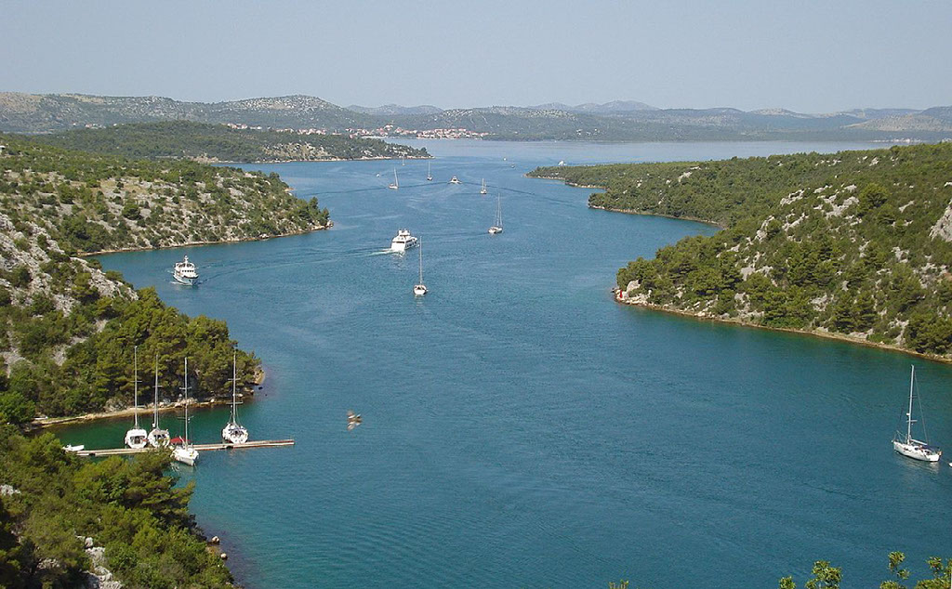
Prokljansko Lake
Prukljansko Lake (or Prokljansko Lake) is a lake in Croatia, part of the Krka National Park. Due to the contact of the sea, the water in the surface layer is brackish, and at the bottom it is salty. The island of Stipanac is also located in the lake.
Krka River entering Prokljan Lake.
Source: https://commons.wikimedia.org/wiki/File:Krka_i_Prokljansko_jezero.jpg

Slide 9
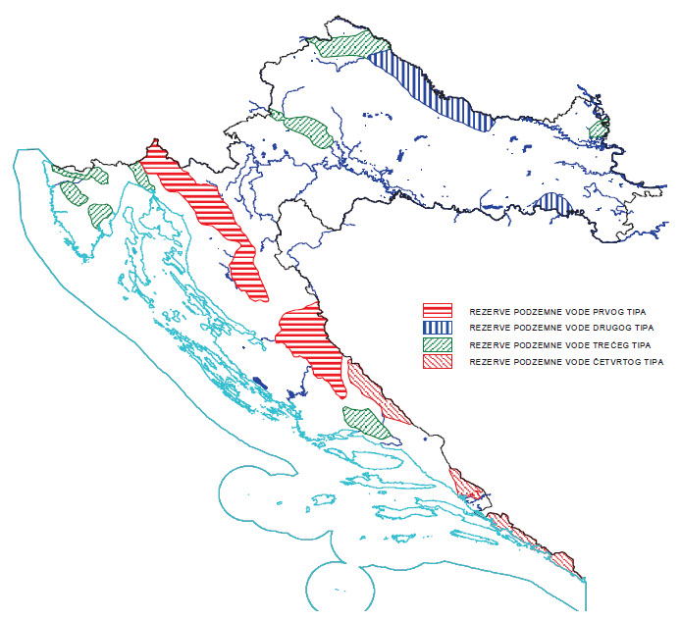
Groundwater in Croatia
Karst groundwater is of special importance for Croatia, since 50% of our country is covered with karst. Karst aquifers contain strategic groundwater reserves of Croatia, which in terms of quantity and exceptional quality can meet the water supply needs of entire regions and ensure significant economic and social development of Croatian society. Such significant natural resources need to be protected through efforts to preserve the natural quality of groundwater.
Strategic groundwater reserves. Source: Biondić, D., Water Management Strategy, 2009.

Slide 10
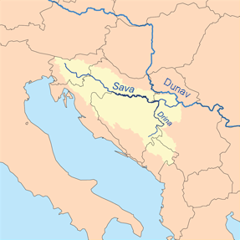
Rivers
The Sava is the longest Croatian river (by which we mean the river with the longest watercourse in Croatia). The Sava is 946 kilometers long, of which 510 kilometers pass through Croatia.
Sava
The Sava River springs in northwestern Slovenia, is a tributary of the Danube, and the confluence of the Sava is in Belgrade. It is part of the Black Sea basin. In Croatia, it runs as much as 510 kilometers. From the source to the mouth of the Sava, it passes through four countries - Slovenia, Croatia, Bosnia and Herzegovina and Serbia. It connects as many as three capitals - Ljubljana, Zagreb and Belgrade. The Croatian rivers Sutla, Krapina, Lonja, Kupa or Orljava are just some of the numerous tributaries of the Sava River.
Sava River watershed. Source: https://commons.wikimedia.org/wiki/File:Savarivermap_hr.png

Slide 11
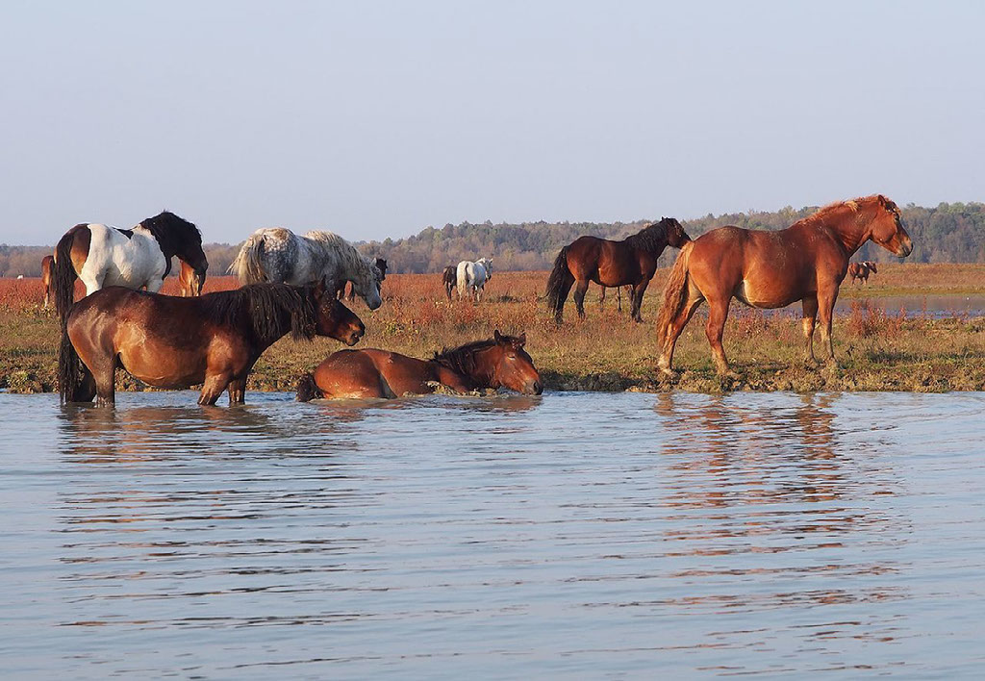
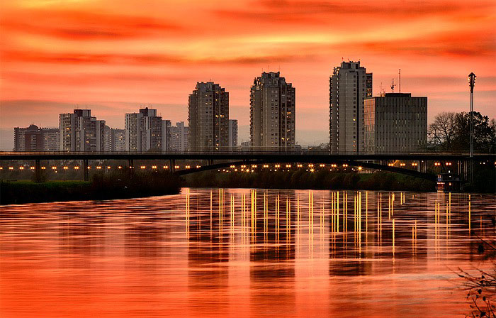
The Sava River Basin is characterized by biological diversity. In its basin there are wet habitats Lonjsko polje and the pond Crna Mlaka. On June 1, the Sava River Day is celebrated in the basin countries with numerous activities with the aim of promoting awareness of the importance of the river.
Economic activities and social life (eg recreational bathing areas on the Sava) of the inhabitants of the Sava areas have always been connected to the river. The Sava River is also ecologically important for Croatia and neighboring countries.
Lonjsko polje. Source: https://commons.wikimedia.org/wiki/File:Konji_na_ispa%C5%A1i.jpg
Sava (Zagreb). Source: https://commons.wikimedia.org/wiki/File:Zagreb_skyline.jpg

Slide 12
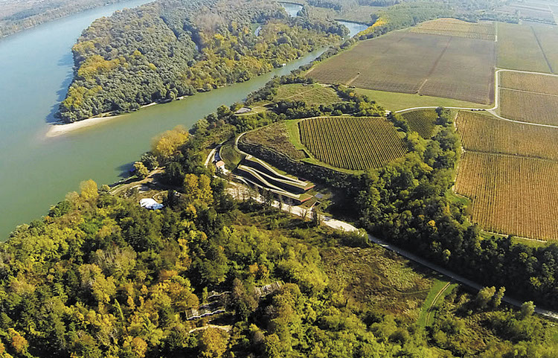
Dunav (Danube, Dunaj, Duna, Dunarii, Dunau)
The second longest river in Europe (the longest river in the European Union), the Danube River has a 2,857-kilometer-long watercourse. It passes through or forms the border of ten European countries, namely Germany, Austria, Slovakia, Hungary, Croatia, Serbia, Romania, Bulgaria, Moldova and Ukraine. Due to its length and position, the Danube was significant in the European past as well. The Vučedol culture originated and developed along the Danube almost five thousand years ago in the area of ​​today's Vukovar-Srijem County.
Vučedol Culture Museum. Source: https://hrvatski-vojnik.hr/wp-content/uploads/2019/12/594-crtice-1.jpg

Slide 13
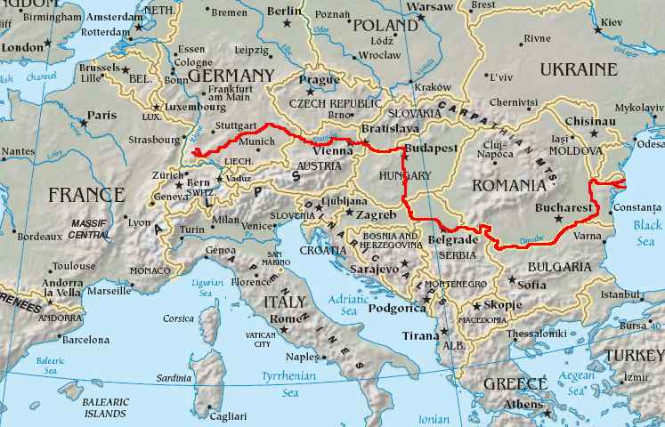
The second longest river in Europe (the longest river in the European Union), the Danube River has a 2,857-kilometer-long watercourse. It passes through or forms the border of ten European countries, namely Germany, Austria, Slovakia, Hungary, Croatia, Serbia, Romania, Bulgaria, Moldova and Ukraine.
The Danube springs in the mountainous area of ​​the Black Forest in southwestern Germany where it makes its way to the confluence with the Black Sea. The Danube Delta is mostly located in Romania and is on the UNESCO World Heritage List due to its exceptional biodiversity. Romania also has the largest part of the total length of the Danube.
Map showing the flow of the Danube River. Source: https://commons.wikimedia.org/wiki/File:Danubemap.png

Slide 14
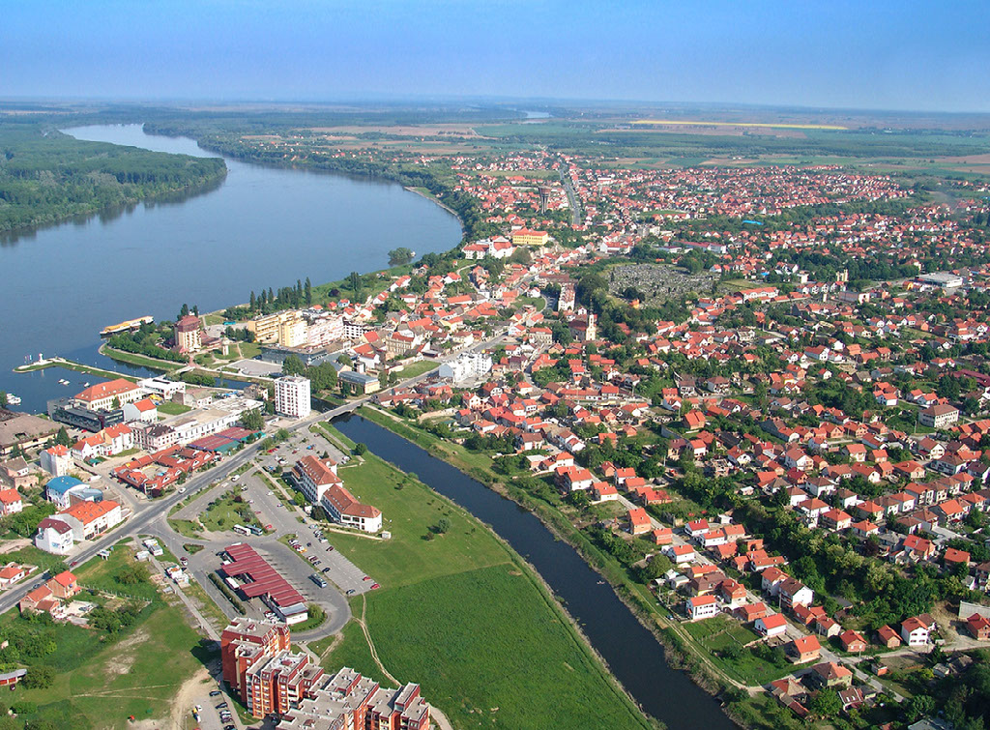
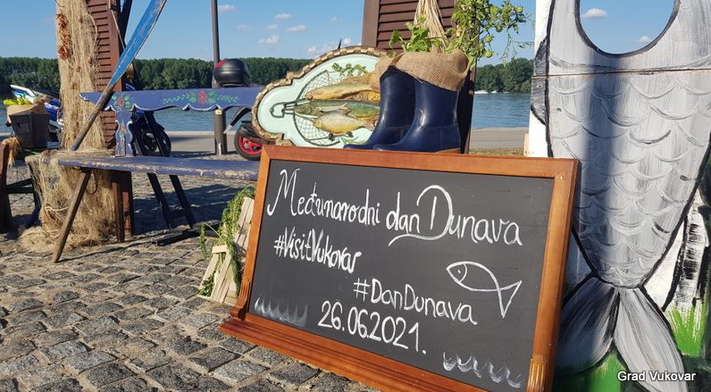
In Croatia, out of almost 3,000 kilometers long watercourse, there are only 138 kilometers (of which 130 form the natural state border). The Danube flows into Croatia from Hungary. The most important port city on the Croatian bank of the Danube is Vukovar.
The Danube basin is the largest in Croatia. Among the numerous tributaries of the Danube are the longest Croatian rivers, the Sava and the Drava. June 29 marks the International Danube Day. Croatia is one of the signatories of the 1994 Danube River Protection Convention.
Vukovar. Source: https://www.visitvukovar-srijem.com/files/g/1-405/vukovar-iz-zraka-naslovna.jpg
International Danube Day in Vukovar. Source: https://cronika.hr/wp-content/uploads/2021/06/Screenshot-2021-06-27-at-16.34.13-1.png

Slide 15
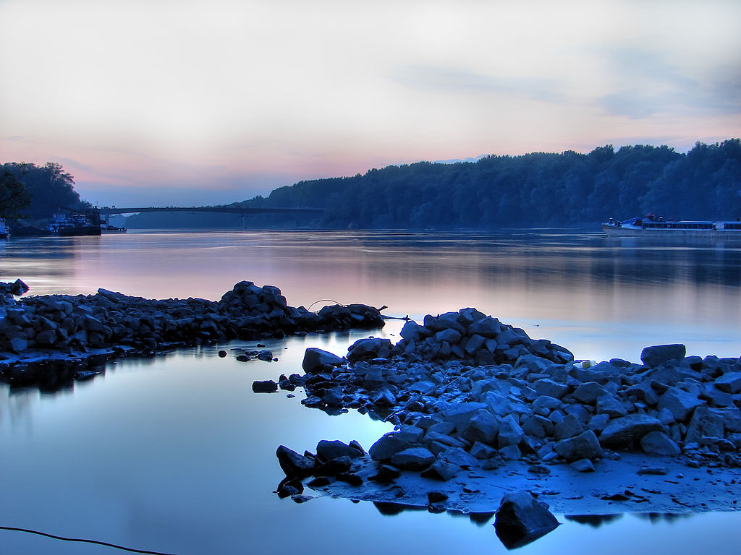
Drava
The Drava is a river of the Black Sea basin adorned with exceptional biodiversity. The Drava is one of the largest tributaries of the Danube. The Drava River passes through five countries and connects the Pannonian and Alpine areas of Central Europe. After Italy (where it springs, in the Toblach area) and Austria (where a large part of the watercourse is located), the Drava enters Croatia in the north of the country, passing through Međimurje where it soon becomes the natural state border of Croatia and Hungary. Its 749-kilometer-long watercourse ends in the Danube in eastern Croatia, on the border between Croatia and Serbia. The Drava is the second river with the longest watercourse in Croatia. In Croatia, it flows with a total length of 323 kilometers. Almost one sixth of the total area of ​​its basin is located in Croatia - about seven thousand square kilometars.
Drava river near Osijek. Source: https://commons.wikimedia.org/wiki/File:Moja_Drava.jpg

Slide 16
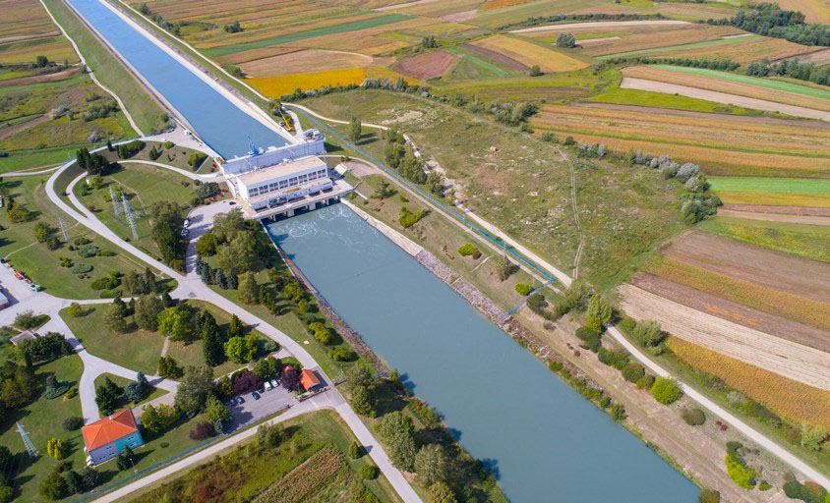
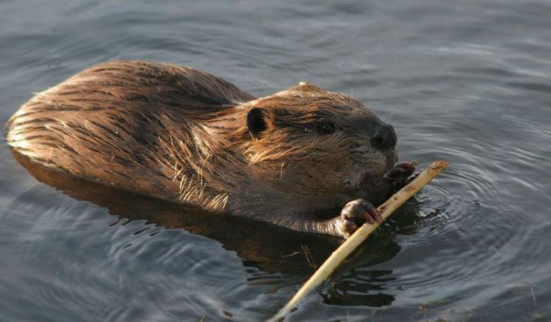
The countries through which the Drava passes use the river for economic purposes as well - There are as many as 23 hydroelectric power plants on the Drava. Due to the melting of glaciers, the Drava has the highest flow in summer.
Numerous and diverse natural habitats of the Drava River are home to diverse flora and fauna. As many as 70 species of fish have been recorded in the Drava (more than in any other Croatian river), five of which are endemic to the Danube basin area. Numerous insects, amphibians and birds live along the Drava. Also, in the area of ​​the river in recent years (after they became regionally extinct in the 19th century), the families of the beaver - the largest rodent of our hemisphere - have settled.
Hydroelectric power plant Varazdin. Source: https://www.hep.hr/proizvodnja/userdocsimages//slike/HE%20Varazdin/HE_Varazdin_1.jpg?width=844&height=512&mode=crop
Beaver in the Drava. Source:https://d35nxk5xx1d0px.cloudfront.net/repository/images/_variations/4/8/a/7/48a78d5409a4cd90e5464f87b1244f14_view_article_new.jpg?v=20

Slide 17
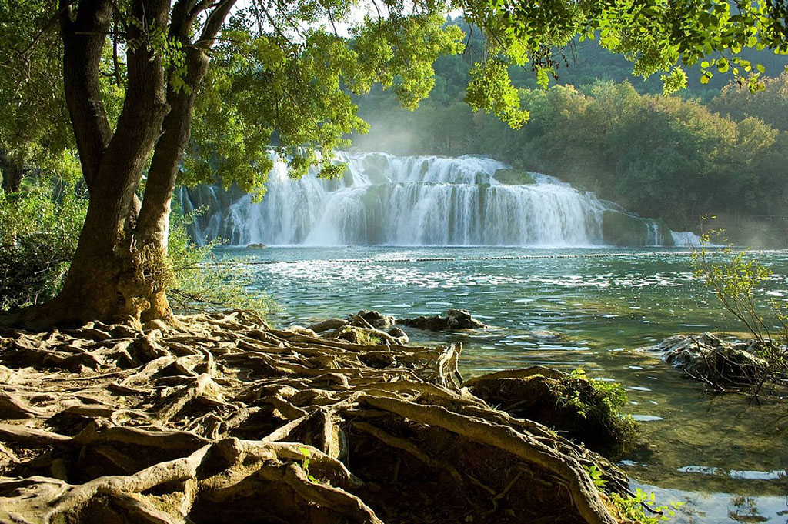
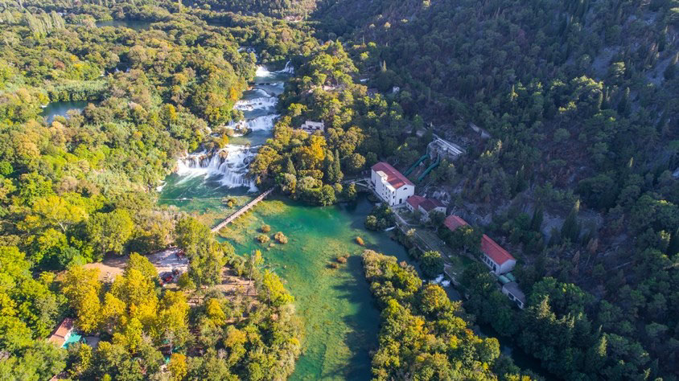
Krka
The Krka is a small river in Croatia 72.5 km long. It springs on the Dinara and flows into the Adriatic Sea. The Krka River from Knin to Skradin has been declared a National Park. This national park is known for its beautiful waterfalls and the first hydroelectric power plant in Europe (Jaruga), and the second in the world. It was built just days after the one in Niagara.
Krka National Park. Source: https://upload.wikimedia.org/wikipedia/commons/1/19/Nacionalni_Park_Krka_%28Krka_National_Park%29_-_panoramio.jpg
Accommodation of the Jaruga Hydroelectric Power Plant below waterfall Skradinski Buk (Krka). Source: https://www.hep.hr/proizvodnja/userdocsimages//slike/HE%20Jaruga/HE_Jaruga_1.jpg?width=844&height=512&mode=crop

Slide 18
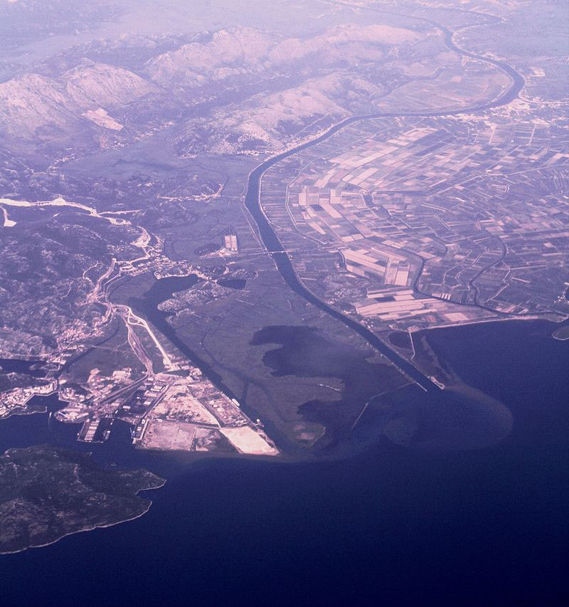
Neretva
The Neretva is a 225 km long river that springs in Zelenogora in BiH and flows into the Adriatic Sea in Croatia. Neretva is known for the Neretva delta in which many mandarins are produced. At the mouth of the Neretva, the Neretva Cup and the Neretva kite open, windsurfing and kitesurfing regattas are held.
Aerial view of the delta of the river Neretva, the largest river flowing into the Adriatic from Croatia. Source: https://upload.wikimedia.org/wikipedia/commons/1/1f/Dalmatia_Neretva_river_delta_IMG_9877.JPG

Slide 19
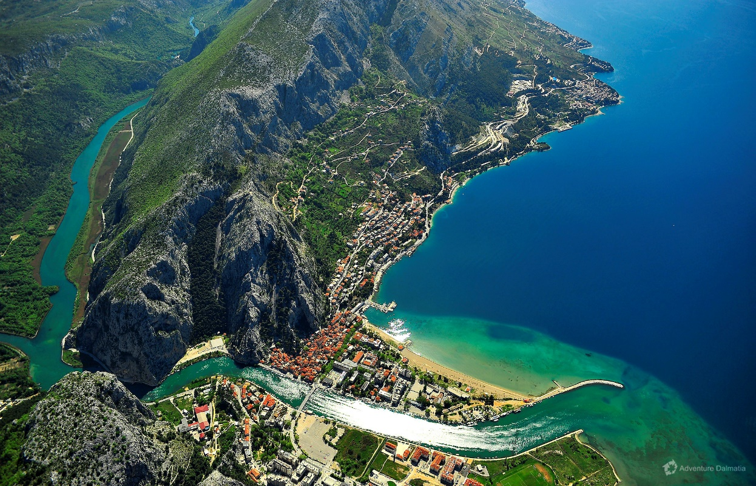
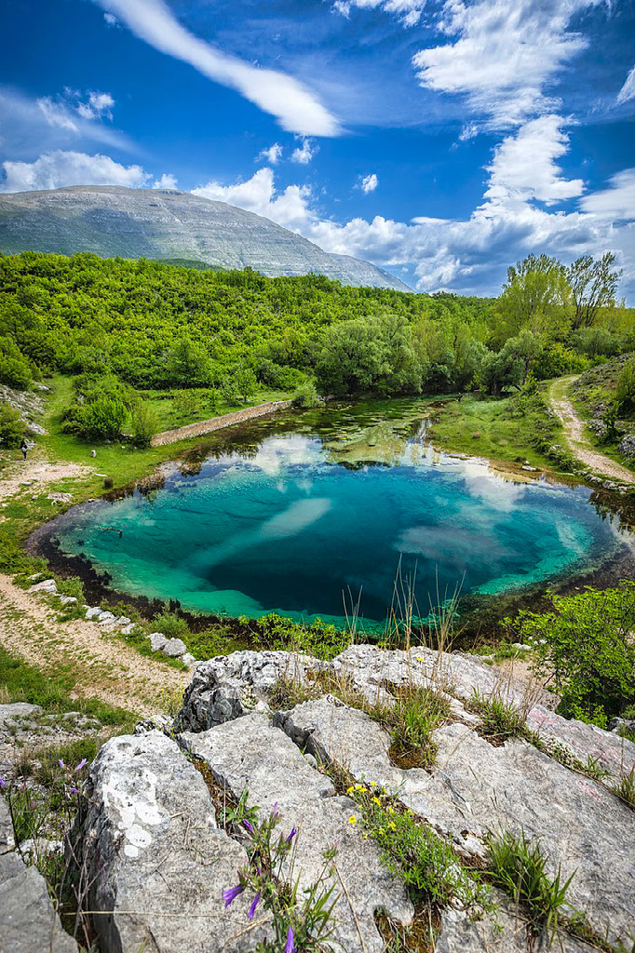
Cetina
The Cetina River in Croatia is 105 km long, springs on the Dinara and flows into the Adriatic Sea in Omis. It is known for its beautiful canyon, fields and fortresses along the river. There are as many as five hydroelectric power plants on the river Cetina; Peruča, Orlovac, Đale Zakučac, Kraljevac.
Biggest, and deepest wellspring of river Cetina in Croatia. Source: https://upload.wikimedia.org/wikipedia/commons/f/f5/The_Eye_of_Cetina.jpg
The mouth of the Cetina River in Omiš. Source: https://splitadventure.com/wp-content/uploads/omis-town-cetina-river-02.jpg

Slide 20
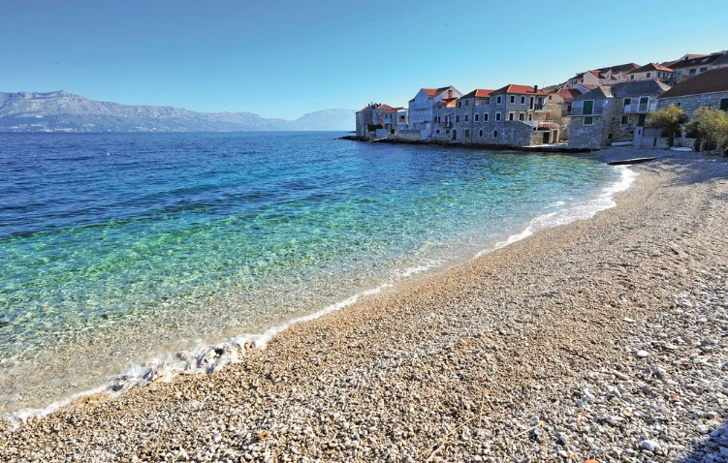
Island of Brač
The river Cetina brought us to the island of Brac, which is located in the beautiful Adriatic Sea. Namely, the river Cetina with the constructed water supply system, supplies drinking water to the islands of Brač, Hvar and Šolta.
Postira, Island of Brač. Source: https://image.novasol.com/pic/1024/cdb/201712071640/cdb_associated_21.jpg

Slide 21
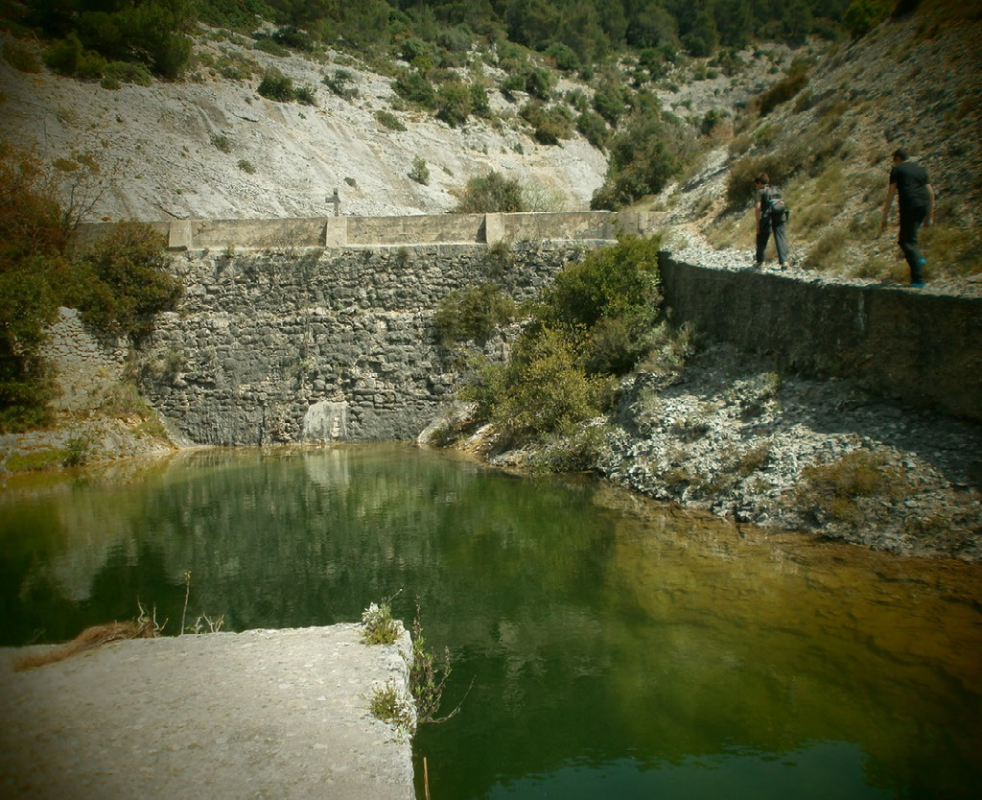
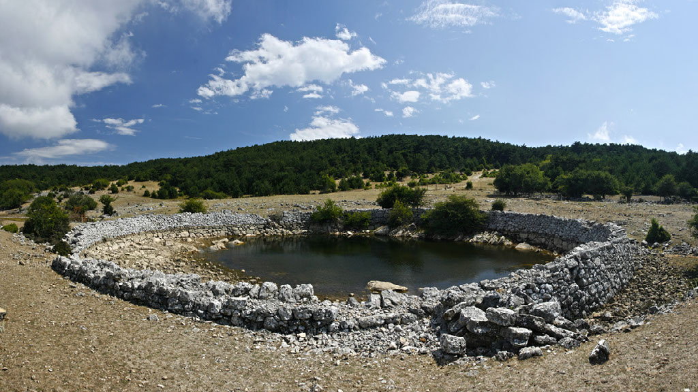
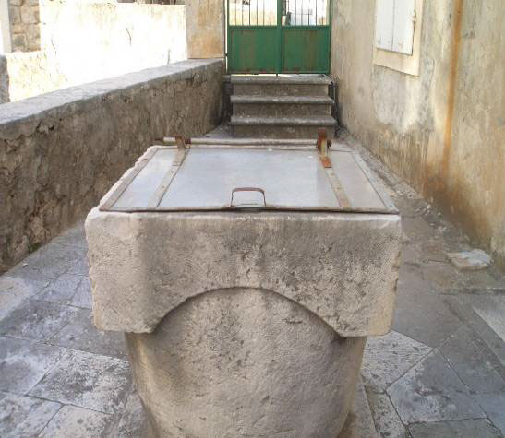
In the past, the island was supplied with water through drips, wells and smaller local springs.
Stivinjoci, rainwater reservoir (source: School project - Waters of the island of Brač)
Well (source: School project - Waters of the island of Brač)
Trolokve, built watering hole (source: School project - Waters of the island of Brač)

Slide 22
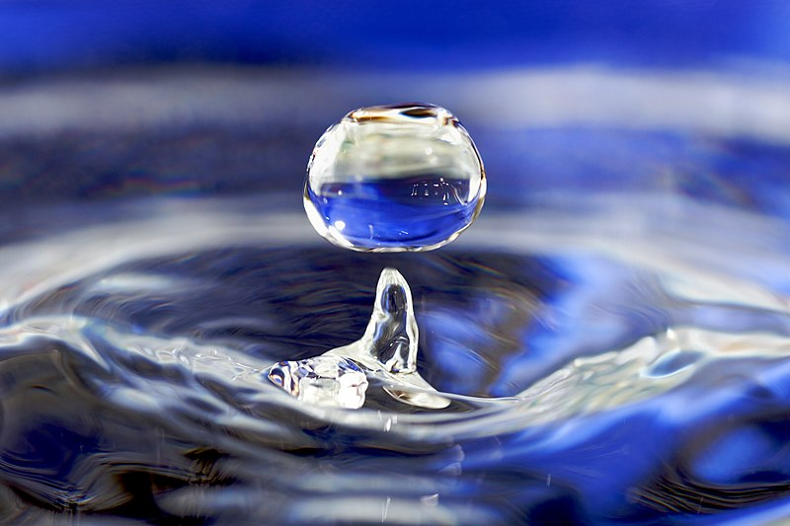
The water is an essence of life ...
The water is an essence of life. It covers 71% of the surface of the planet Earth. 97,5% of that is salt water and 2,5% is fresh water. Most of the fresh is in glaciers (68,9). Other part is underground water (30,8) and only 0,3% of the fresh wather is in lakes and rivers. Only 1% of fresh water is good for drinking.
Source: https://upload.wikimedia.org/wikipedia/commons/thumb/5/5e/Water_drop_001.jpg/800px-Water_drop_001.jpg

Slide 23
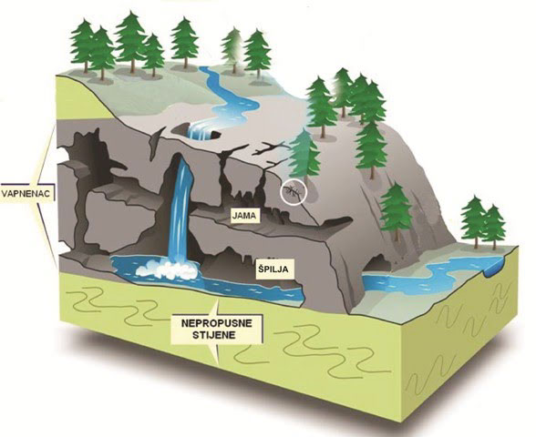
Croatia has significant reserves of drinking water. It is in top 10 Euopean countries. 80% of Croatian people use water from public water supplies, and the rest of them use water from wells and cisterns. We can be thankful for that aboundance of fresh drinking water because of the big rivers: Dunav, Drava and Sava. Also what takes part in this great aboundance are large amounts of rainfall in the Dinarides mountain area. The problem is uneqval distribution of rainfall ( long dry summer and a lot of rain in autum).
Underground karst relief forms. Source: https://sites.google.com/site/sredozemlje111/home/rasireni-su-krski-krajevi/Jame_i_spilje-podzemni_krski_reljefni_oblici.jpg?attredirects=0

Slide 24
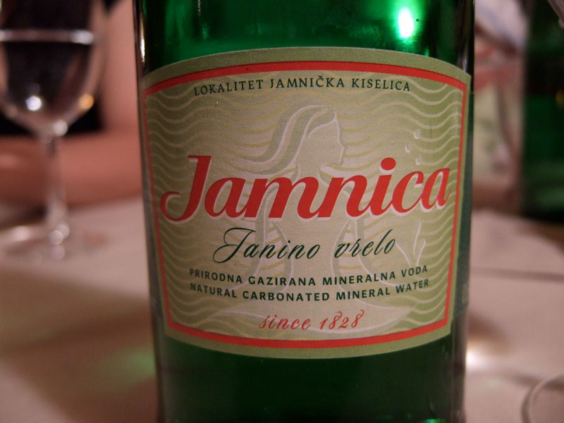
Also, when it comes to high-quality drinking water, the karst area of Croatia with little water on the surface, and a lot of water underground is an invaluable, specific reservoir of drinking water of the highest quality. 90 percent of the water supply is provided from groundwater supplies.
Due to possible pollution, the need to protect these natural resources is exceptional. One of the ways of protection is legal regulation and constant testing and control of Croatian water areas, but also raising citizens' awareness of the complexity and sensitivity of the groundwater system in karst and the way of their protection.
Jamnica is the biggest Croatian producer of mineral and drinking water. They won a gold medal for the best mineral water, 2015. in Portugal.
Source: https://upload.wikimedia.org/wikipedia/commons/7/78/Jamnica_water.jpg

Slide 25
Water is not a commercial product but a heritage that needs to be preserved, protected and used wisely and rationally. Waters are managed according to the principle of unity of the water system and the principle of sustainable development, which satisfy the needs of the current generation and does not endanger the rights and opportunities of future generations. The waters are of good interest to the Republic of Croatia and have its special protection.
Ministry of Economy and Sustainable Development of the Republic of Croatia.

